Slide 1

FORTISURE
INSURANCE POLICY MANAGEMENT SYSTEM
A platform that offers strong, reliable protection for your policies and claims
V Hiranaya B Sindhu
S Gowthami Soumya Priya J Vaishnavi

Slide 2

INTRODUCTION
Managing insurance policies efficiently is essential in the digital era.
Offers a centralized platform for organizing, issuing, and tracking policies.
Enhances customer experience and operational efficiency.
Ensures secure, role-based access for both administrators and customers.

Slide 3
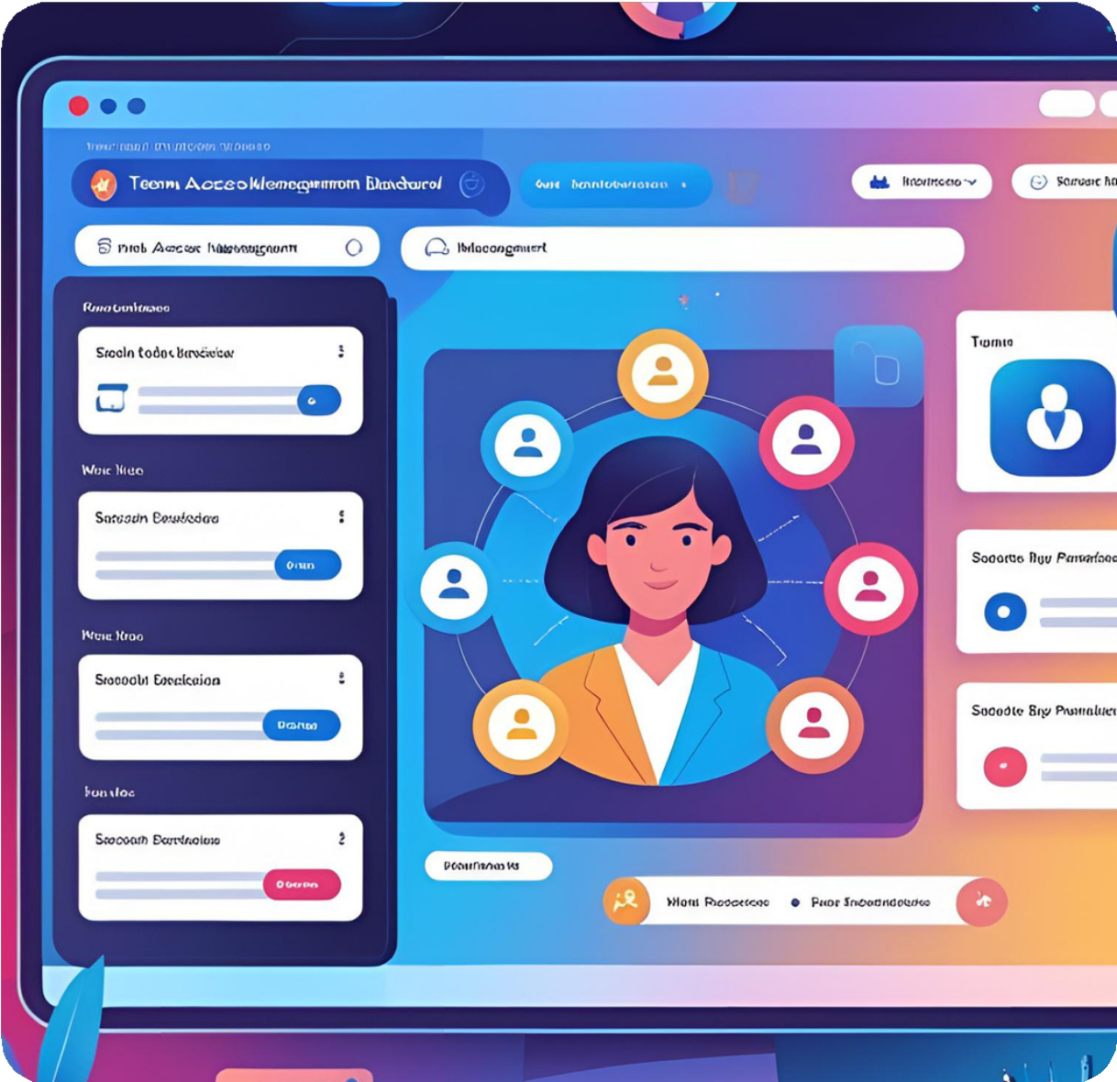
OBJECTIVES
Digitize Policy Management: Replace manual processes with a responsive web application.
Secure Role-Based Access: Use JWT (JSON Web Tokens) to ensure that only authorized users access protected resources.
Seamless Policy Operations: Enable easy
search, view, update, and addition of policies and customer details.

Slide 4

CORE FEATURES
Login Register Policy Search
Policy Management
Secure JWT-based authentication
New customers & admins can sign up
Filter by Policy ID, Policy type, Premium Amount
Admin: Add/View/Update all policy details
Customer: View and update allowed personal info only
Admin Management
Admins can register other admins
Cart System
Statistics Dashboard
Customers can add policies & assign beneficiaries
Visual insights on policy distribution and usage

Slide 5

MODULES
Authentication Module
Handles user registration and login
Implements JWT token-based authentication
Ensures secure access to
protected routes

Slide 6

MODULES
User Module
Allows users to browse categorized policies Manage cart: Add, view, remove policies
Complete purchase and receive policy details

Slide 7

MODULES
Admin Module
Add , view , edit policy details efficiently
Track user Policies and orders through statistics
Add another admin

Slide 8


FUNCTIONALITIES
Secure user registration and login. Classified policy browsing.
Cart functionality: add, view, remove policies. Policy checkout and generation.
Admin: Create, edit, delete policies. customer: edit personal details
Spinners during transitions for better UX.

Slide 9


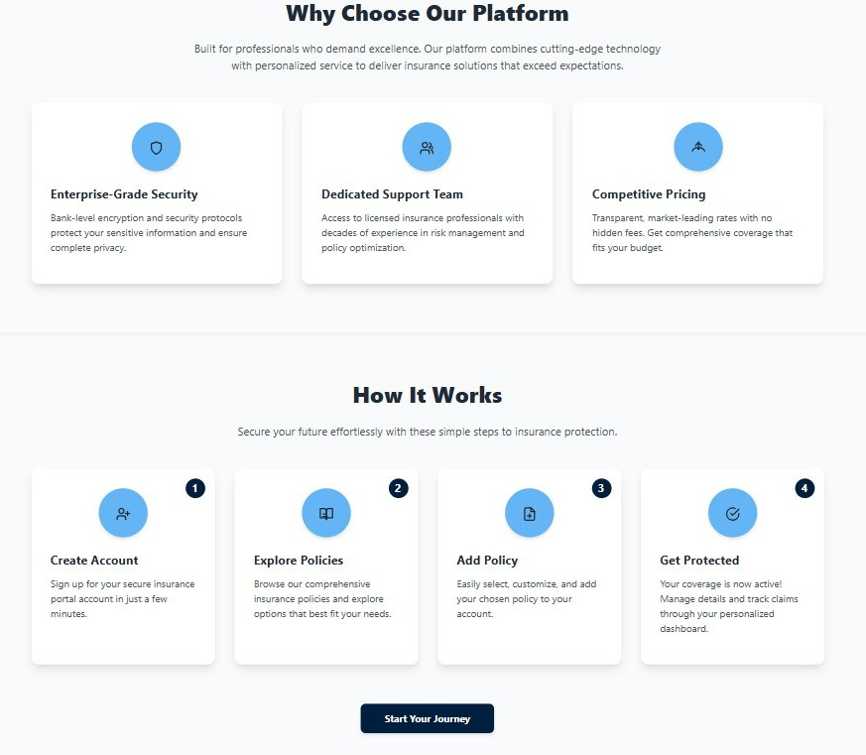
Output
Home Page

Slide 10
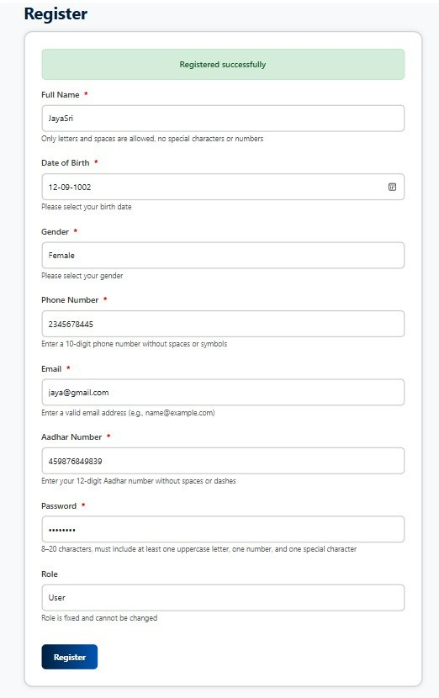
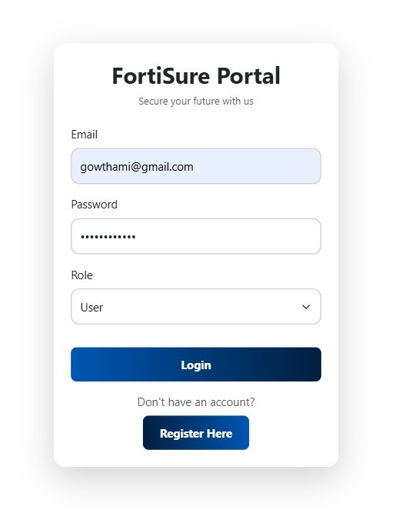
Login & Register

Slide 11

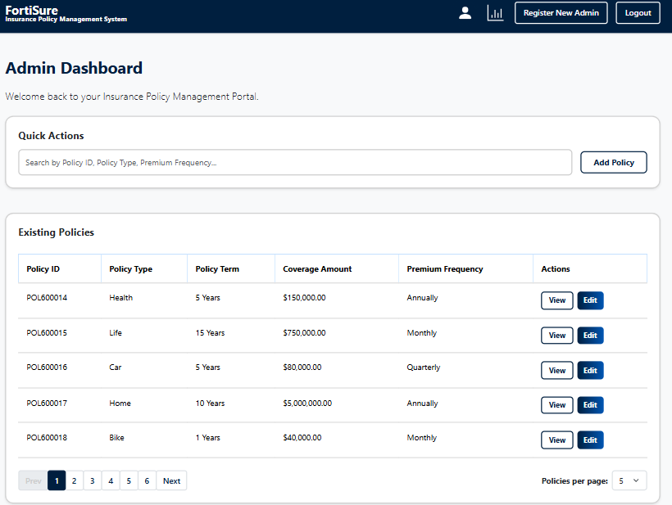
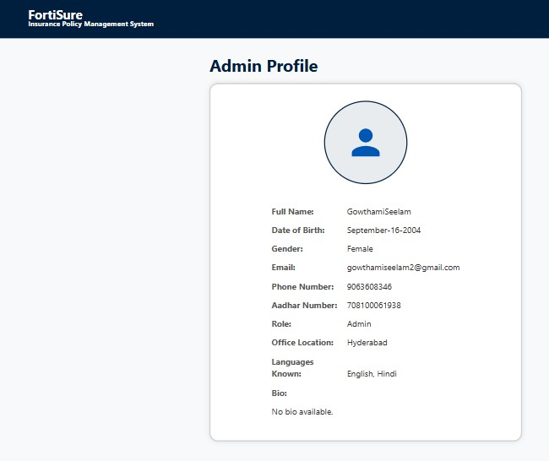
Admin Dashboard

Slide 12
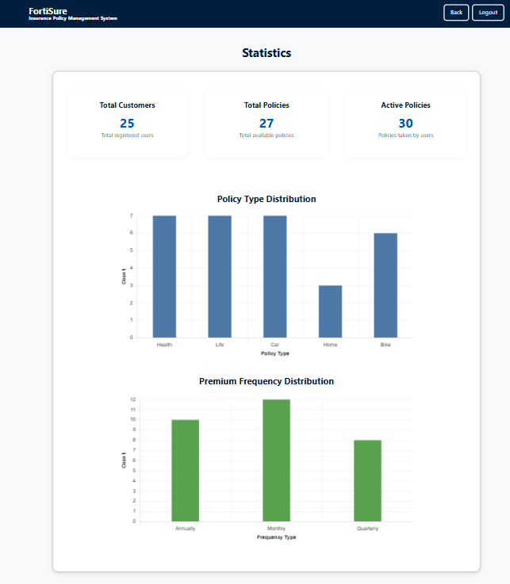
Admin Dashboard - Statistics

Slide 13
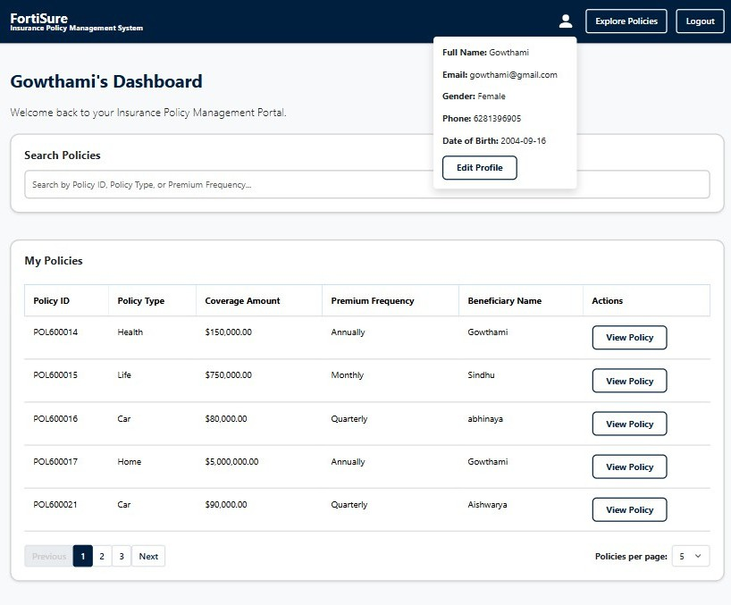
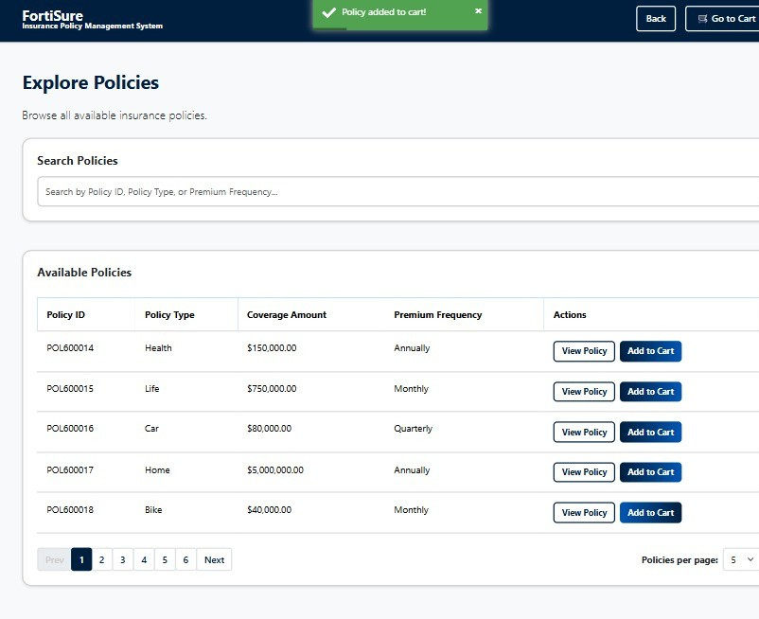
Customer Dashboard

Slide 14

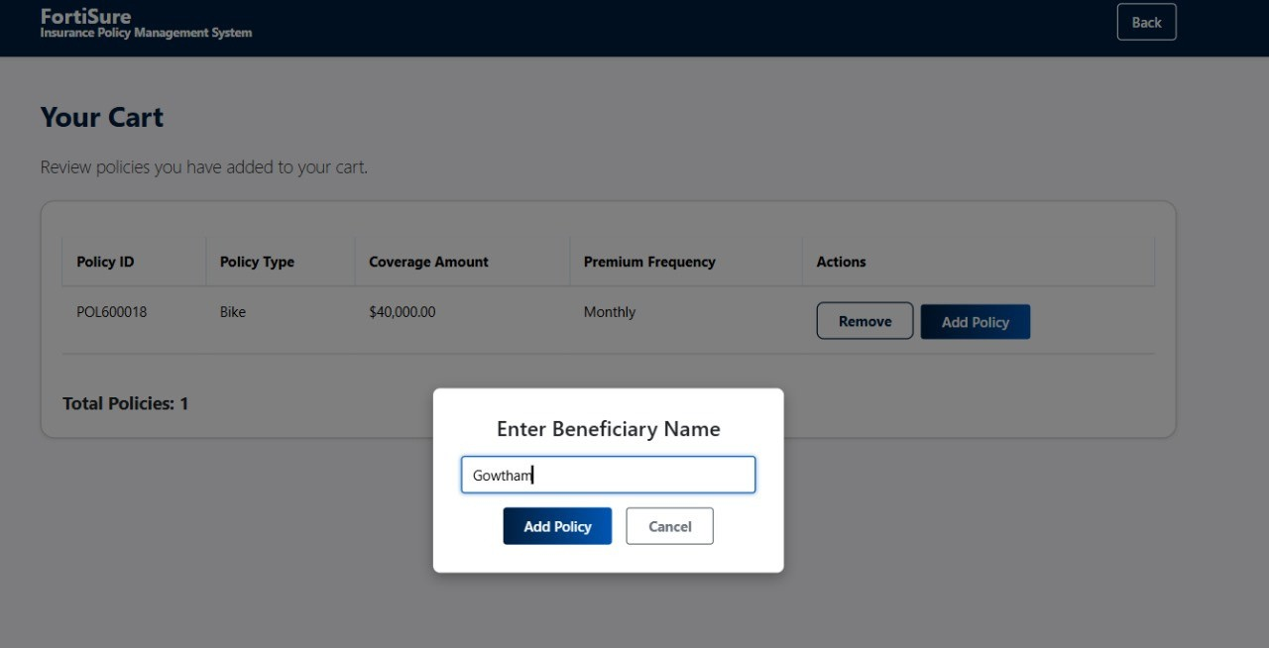
Customer Dashboard - cart

Slide 15


CONCLUSION
The Insurance Policy Management System provides a robust and scalable platform for efficiently handling insurance operations.
With secure authentication, categorized policy browsing, and seamless backend operations, it aims to bridge the gap between insurers and customers through a modern web solution.

Slide 16
THANK YOU

